Slide 1
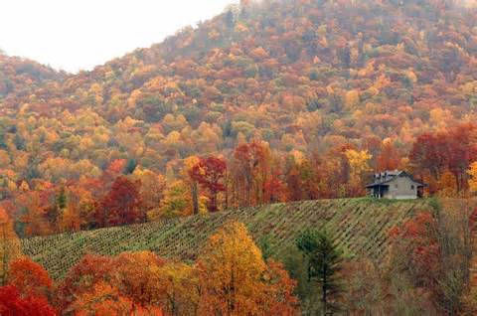
Fall Tone Words
With the right words you will be unstoppable

Slide 2
admonitory
containing a warning; corrective

Slide 3
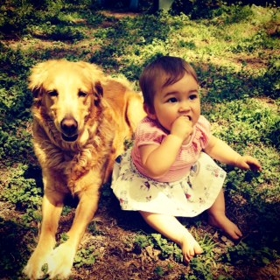
amiable
a friendly personality

Slide 4
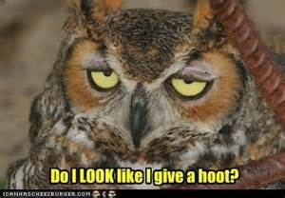
apathetic
showing a lack of interest and/or emotion

Slide 5
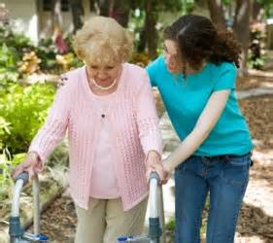
benevolent
characterized by a desire to help others

Slide 6
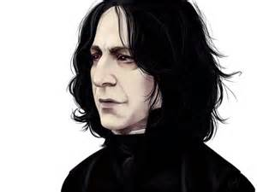
callous
insensitive, unsympathetic and hardened

Slide 7
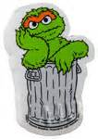
cynical
believing the worst; pessimistic

Slide 8
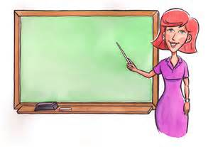
didactic
instructive; teaching

Slide 9
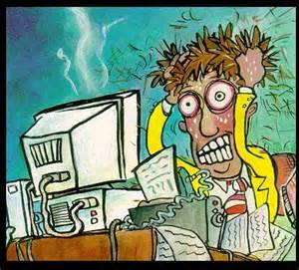
disgruntled
frustrated with something out of your control

Slide 10
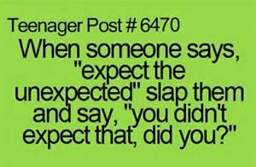
facetious
not meant to be taken seriously; clever sarcasm

Slide 11
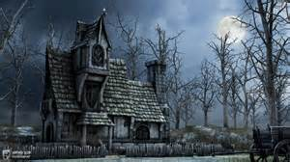
foreboding
predicting misfortune

Slide 12
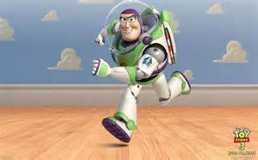
incredulous
unwilling to accept what is said to them or is happening in front of them

Slide 13
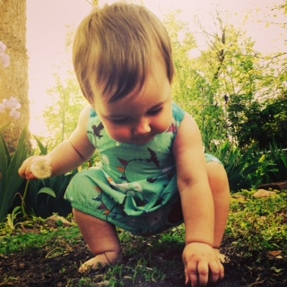
inquisitive
eager for knowledge

Slide 14
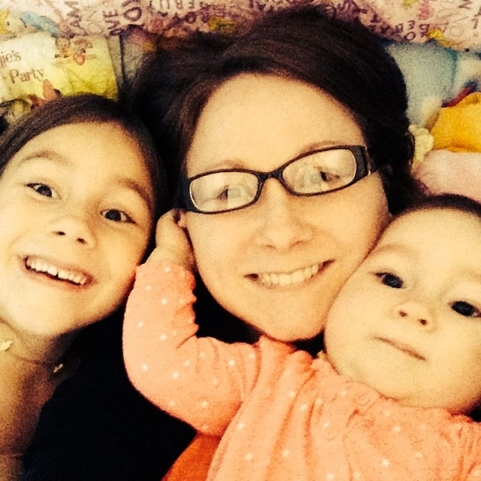
jovial
celebratory; full of happiness

Slide 15
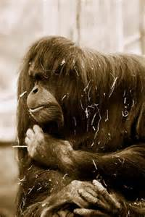
melancholy
a lengthy gloomy state of mind

Slide 16
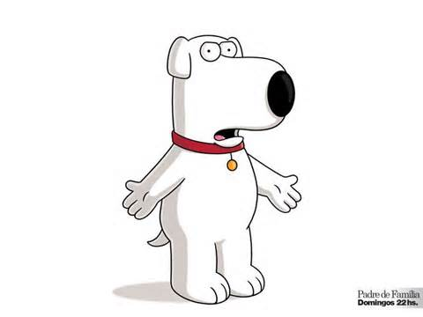
patronizing
acting superior

Slide 17
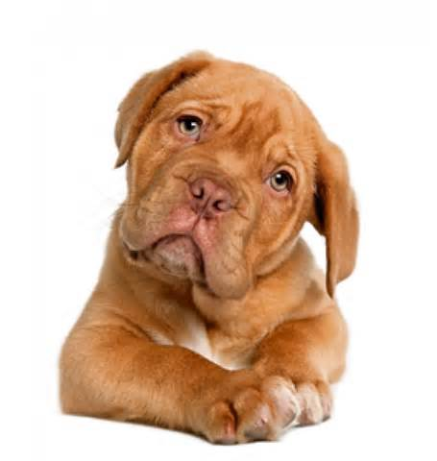
quizzical
questioning or puzzled

Slide 18
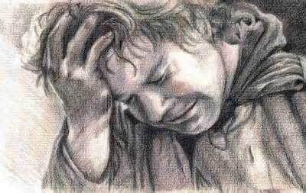
remorseful
feeling regret for wrongdoing

Slide 19
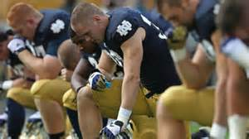
reverent
showing intense respect for someone

Slide 20
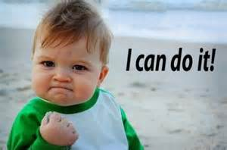
sanguine
cheerfully optimistic

Slide 21
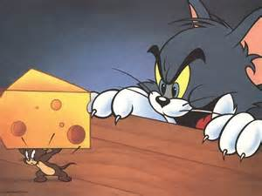
scornful
showing intense anger towards someone; disgusted

