Slide 1
Sketchnotes
A new way to take notes.

Slide 2
How many of us LOVE to take notes?
Anybody? You wake up and think “YES! I get to take notes today!” What if I told you it could be different?

Slide 3
INTRODUCTION
For many years researchers have been proving that writing out notes helps you retain knowledge. The problem we run into is taking notes by hand or really at all is dull and monotonous, but there is information we need. So how can we make it fun?

Slide 4
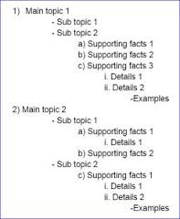
Does this look familiar?
The Outline Method’s Benefits
It is more visual pleasing
It allows for structure

Slide 5
Cornell Notes
Have you seen these before?
If not you will.
They are a great way to organize terms and fold at the line so you can test yourself.
They also are a very organized structured way to take notes.

Slide 6
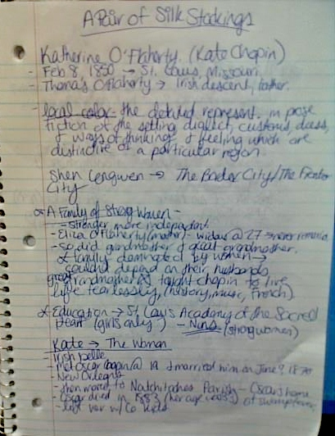
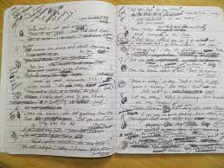
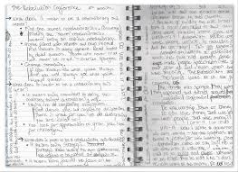
What do our notes usually look like?

Slide 7
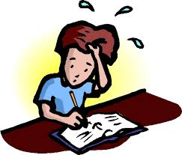
What if I told you there was a better way to take notes that didn’t leave you feeling like this: One that allows you to be creative and have a little fun? It is also PROVEN to help you retain knowledge!

Slide 8
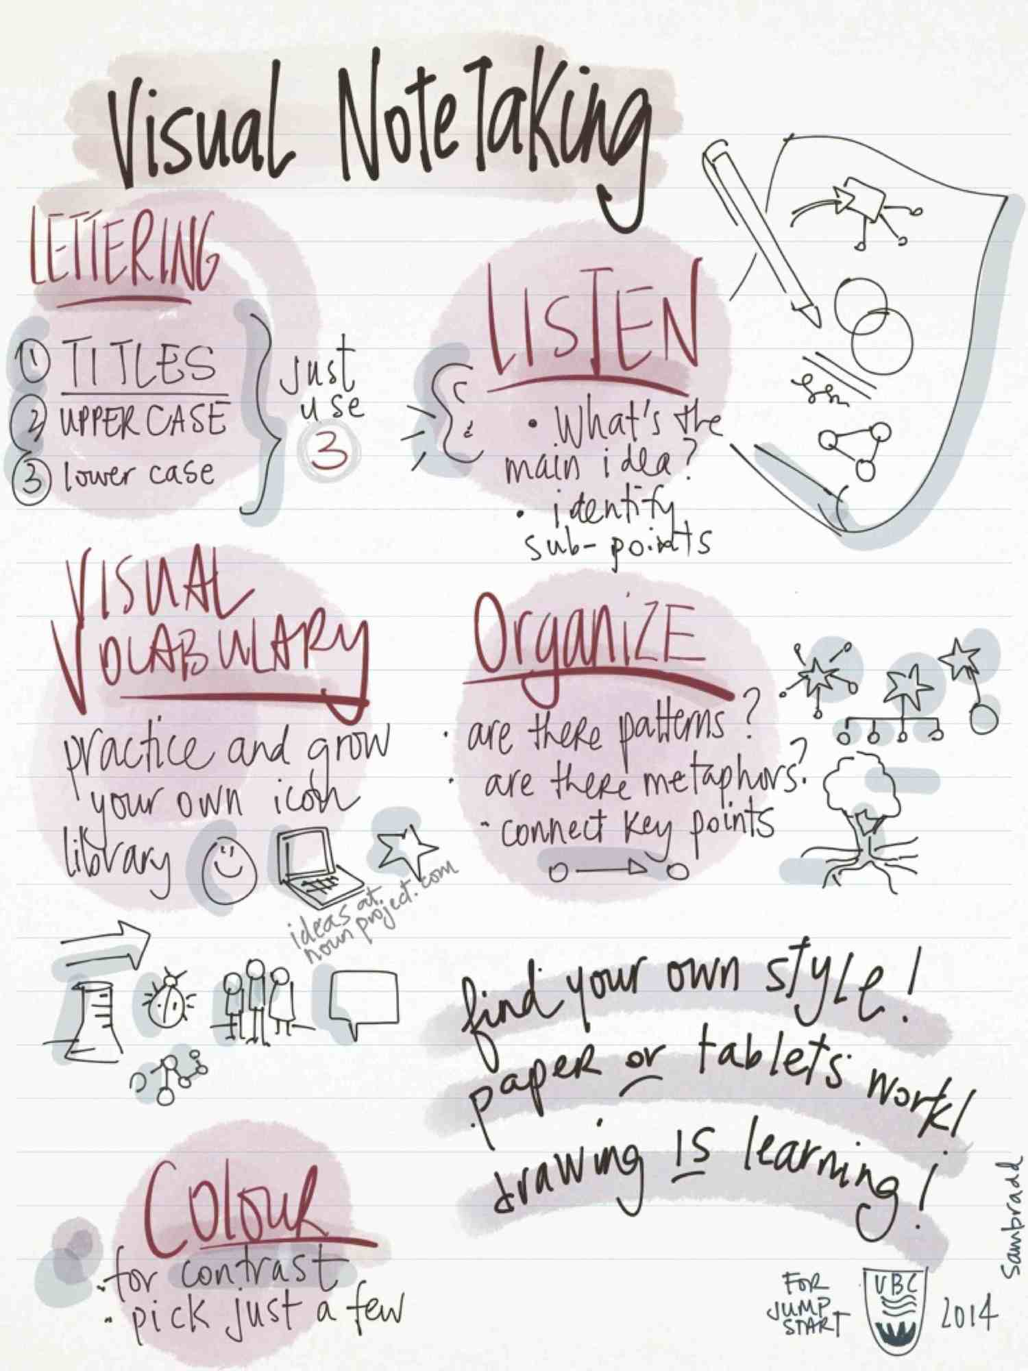
What are Sketchnotes?
Sketchnotes were born of frustration
Notetaking emphasized with doodles
Rich personal visual notes
Ideas NOT ART

Slide 9
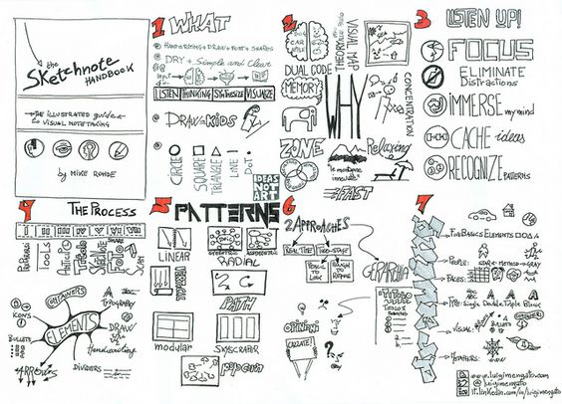
Why Sketchnote?
Sketchnoting engages your whole mind
Sketchnoting creates a visual map
Sketchnoting helps your concentration
Sketchnoting taps your visual language
Sketchnoting is relaxing

Slide 10
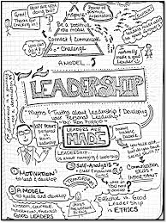
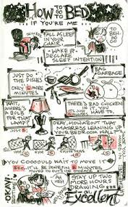
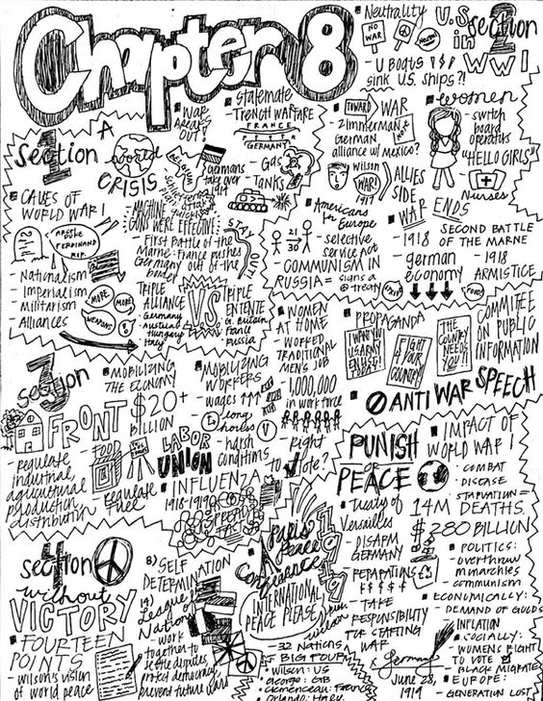
STEP ONE: Title
Take time to create a title
Titles are ideal for defining skechnotes. They can be the unit title, chapter name or number, subject, just whatever the topic

Slide 11
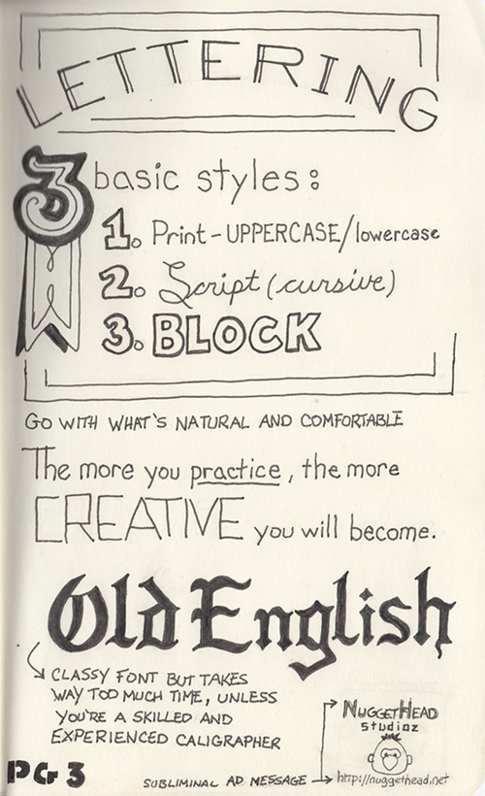
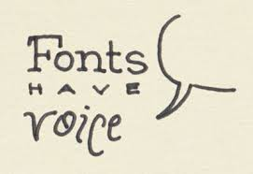
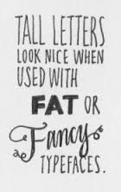
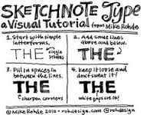
Consider Typography
It is useful to emphasize ideas create a ranking system for your notes so you can decide what to lable them in the order of importance.

Slide 12
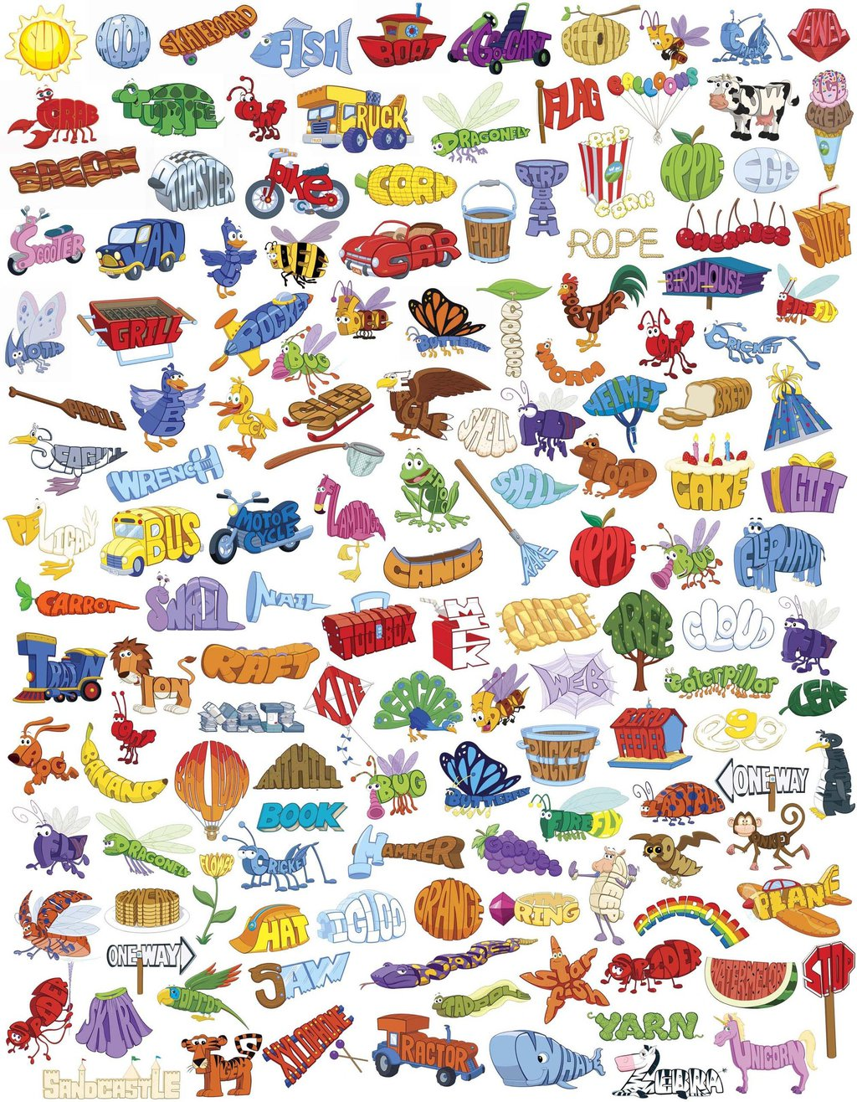

Slide 13
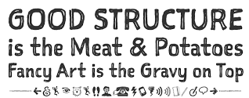
STEP TWO: Make a Legend for your notes
Create a frame/border or icon for the following:
your thoughts
quotes you love/like
questions you have
predictions you have
literary devices
vocabulary (unfamiliar words)
It’s important to decide how you are going to organize your notes. You need to have a method to the madness.

Slide 14
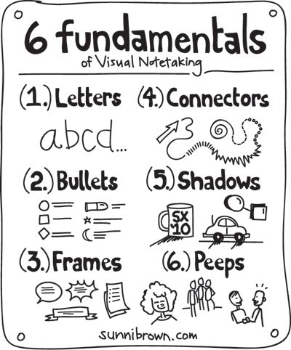
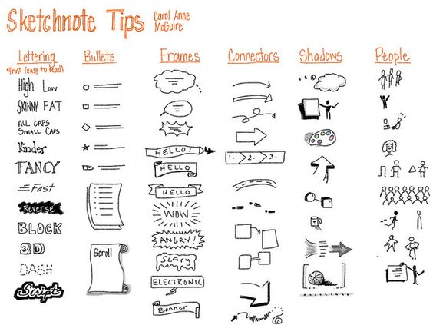

Slide 15
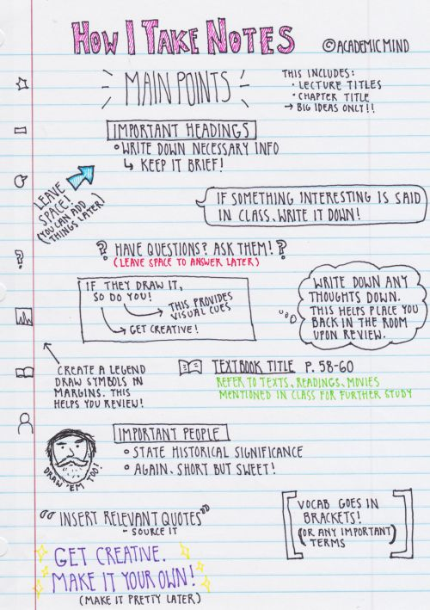
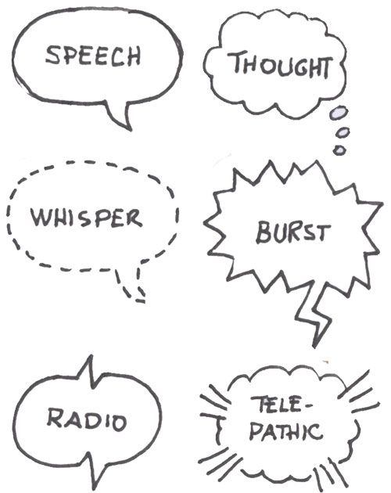
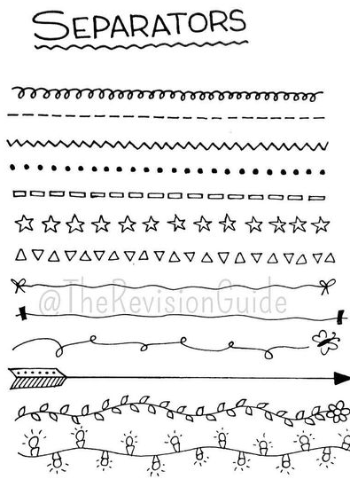

Slide 16
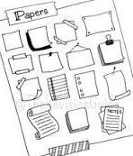
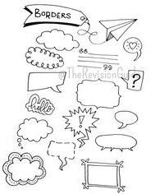
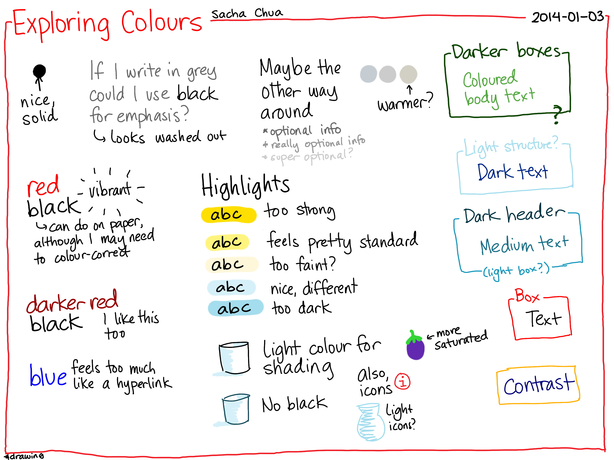
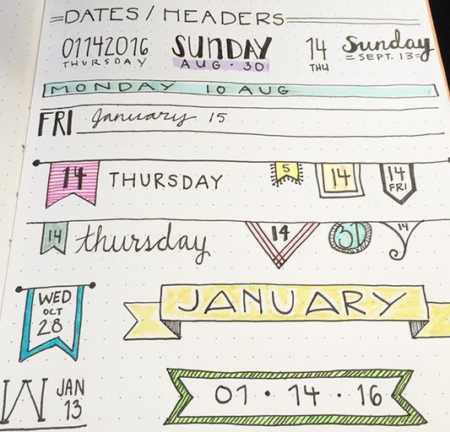
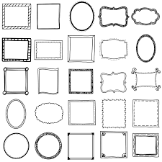

Slide 17
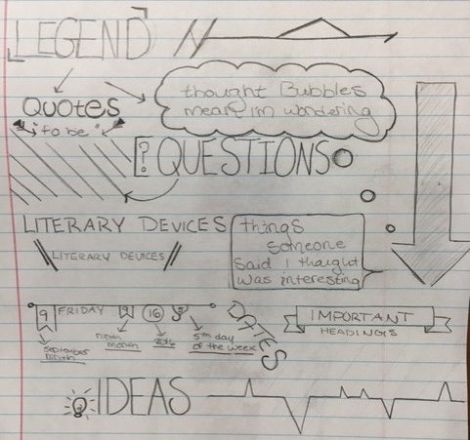
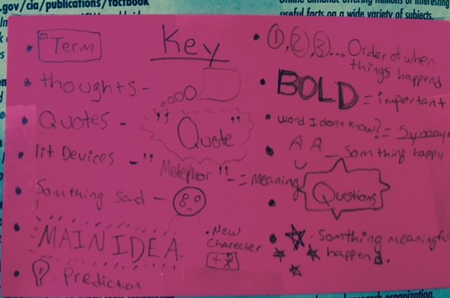
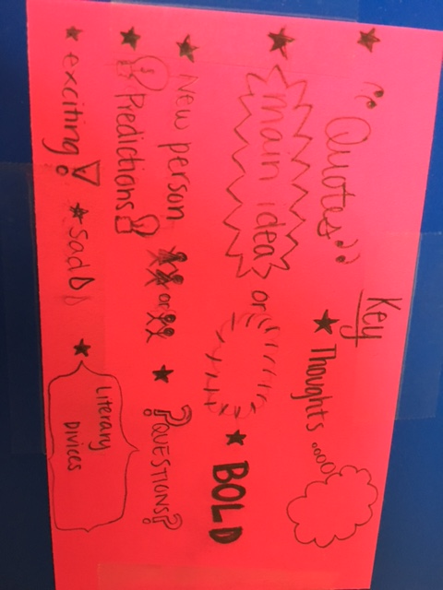
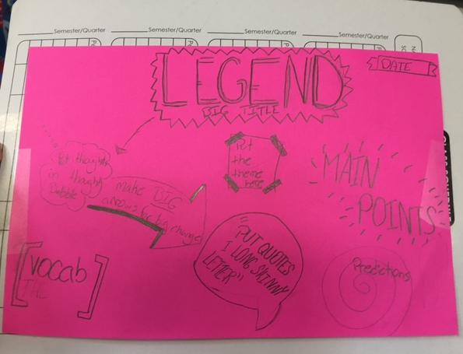

Slide 18
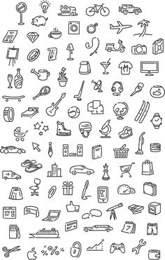
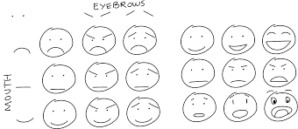
STEP THREE: Confidence
Have confidence that your sketches do not have to be perfect
If you can draw the five elements you can sketch nearly anything
You will get better with time

Slide 19
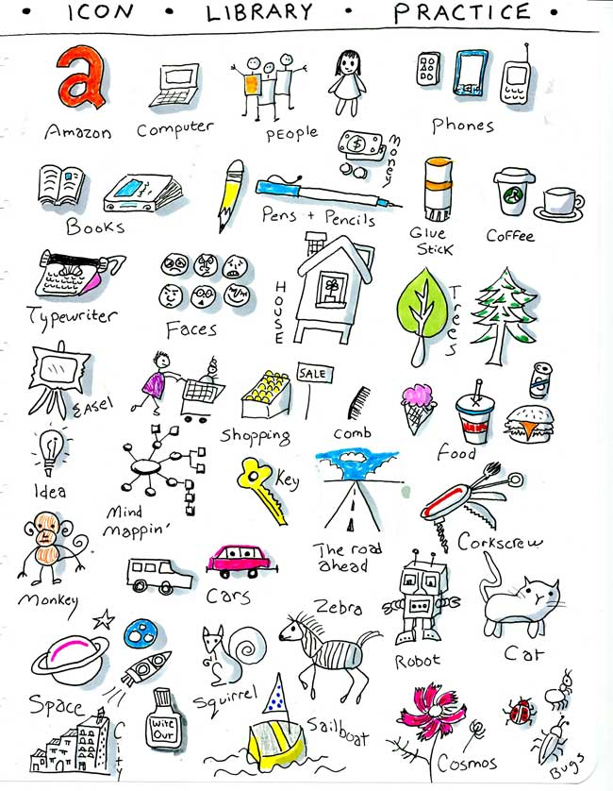
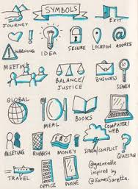

Slide 20
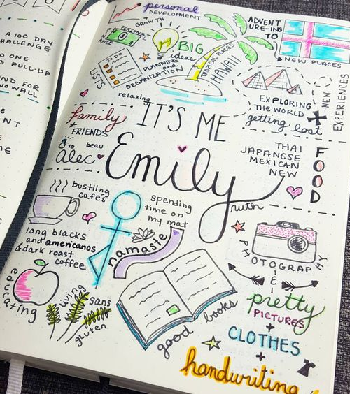
Apply: Now you give it a try!
TODAY IN CLASS:
Go to the first page in your composition notebook and put your name somewhere on the page in a defining font. Around you name add images and words that you love and that makes you happy. You need a total of 10 images/words or phrases.
HOMEWORK:
Sketchnote something: a chapter from the book you are reading, funny conversation with a child, TV show, movie, while you are people watching or a news broadcast.

Slide 21
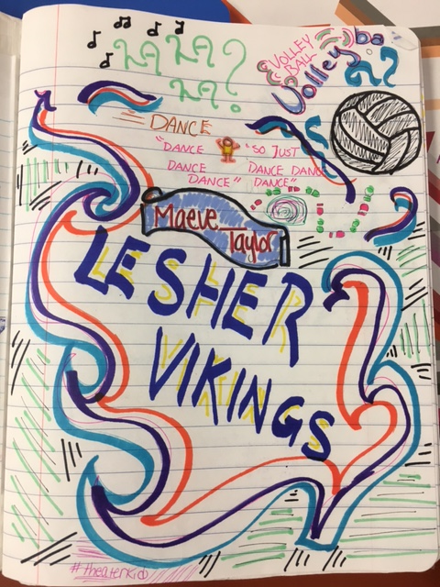
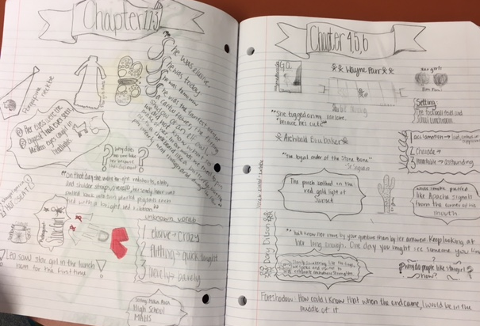
Example of About the Author page:
Example of novel Sketchnotes:

