Slide 1
Literary Terms
Interesting when you read, and useful when you write.

Slide 2
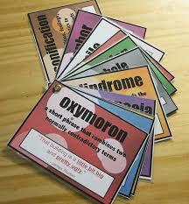
What are literary devices?
Literary devices are techniques writers use to engage their readers beyond the literal meaning of the text.

Slide 3
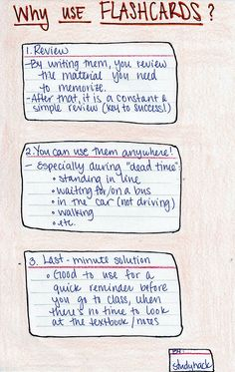
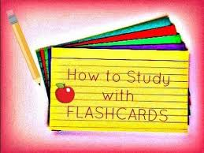
Flashcard INSTRUCTIONS
As you are introduced to each term you need to create a notecard with the word on one side (the blank side) and the definition with an example on the other side (lined side).
You will then hole punch the same corner on all cards and put a paperclip through it.

Slide 4
Flashback
Is a literary device in which an earlier event is inserted into the normal chronological order of a narrative. To put it simply it is a scene from the past. As you watch the following try to decide what makes it a flashback?
https://youtu.be/i5OfSami1jA
https://youtu.be/px0j1EHF8Y0

Slide 5
Characterization
Is the process by which the writer reveals the personality of a character.
Indirect
Direct
the author shows us the character but allows us to interpret for ourselves what kind of person the character is
the author tells readers directly what a character is like or what a person’s motives are

Slide 6
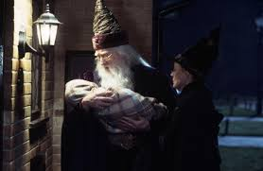
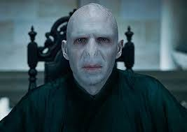
Examples of Characterization
Indirect
For a full minute the three of them stood and looked at the little bundle; Hagrid's shoulders shook, Professor McGonagall blinked furiously, and the twinkling lights that usually shone from Dumbledore's eyes seemed to have gone out (Rawlings 16).
Direct
Voldemort was an evil wizard who wants to kill Harry Potter.

Slide 7
Setting
The time and place in which the events of a work of literature take place.
Setting is important to a narrative. Think about horror stories-they don’t usually take place at midday on a sunny day! They are usually set late at night on a stormy evening-why?

Slide 8
Setting Continued
With a partner, brainstorm a scary setting and list details from the following categories.
Time
Weather
Location
Imagery-think sights, sounds, smells
Mood

Slide 9
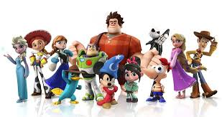
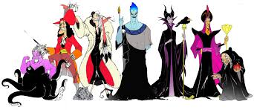
Antagonist/Protagonist
Antagonist-ANTI
Protagonist-PRO
Is a character in a work of literature who opposes the main character.
Is the leading character, or one of the major characters in a work of literature.

Slide 10
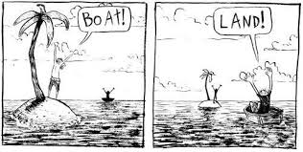
Point-of-View
The perspective or vantage point from which a story is told.
1st person POV: one of the characters is the narrator; uses “I”
3rd person limited: the narrator, who plays no part in the story, zooms in on the thoughts and feelings of just one character
3rd person omniscient: all knowing (Santa); the person telling the story knows everything there is to know about the characters & their problems

Slide 11
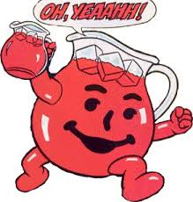
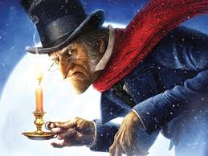
Allusion
A reference to a statement, person, place, event, or thing that is known from literature, history, religion, myth, politics, sports, science, or the arts.
Example: "Christy didn't like to spend money. She was no Scrooge, but she seldom purchased anything except the bare necessities."

Slide 12
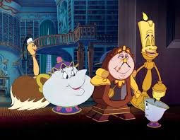
Personification
It is when an author gives human characteristics to a nonhuman thing.
Examples:
My car drank the gasoline in one gulp. The cat laughed. The newspaper headline glared at me.

Slide 13
Dialect
refers to a variety of a language that can signal the speaker’s regional or social background

Slide 14
Dialogue
It is a conversation between two or more people in a work of literature
It is not just words spoken; instead, dialogue reflects an active choice made on the part of each character to instigate conflict and resolve problems, ask and answer questions, and push the narrative along in numerous ways. The way that characters speak hints at their underlying psychoses, desires, motivations, opinions, and so on.

Slide 15
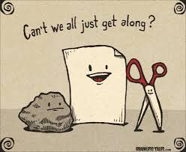
Conflict
A struggle between two opposing forces
External Conflict
Internal Conflict
includes a struggle with an outside source
Examples include:
Man VS Man
Man VS Nature
Man VS Society
takes place in a character’s own mind
Example:
Man VS Himself

Slide 16
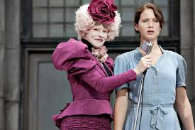
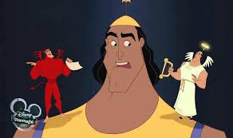
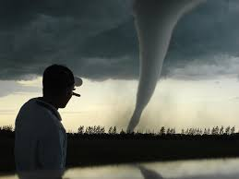
Identify the type of conflict in the following images.

Slide 17
Imagery
when the author uses any of the five senses to create vivid picture in your mind; movie reel effect
Five senses include:
Visual
Auditory
Touch
Taste
Smell

Slide 18
Mood
are the emotions that the author creates and you feel while you are reading.
Setting, tone, and events can affect the mood.

Slide 19
Examples of Mood
Identify the mood in the following sentences:
“Help!” a man yelled “I’ve been shot!” A police officer rushed to the injured man while talking on his walkie-talkie “We need an ambulance here on the south side of Maple Street.”
The flowers dance in the wind while the trees sway to the hymn of the birds chirping their sweet melody.
There was plenty of food, and the music was playing. Everybody was having a good time.

Slide 20
APPLY
CREATE:
In a paragraph use dialog, imagery (at least 3 of the five sense), and mood to create a little movie in the mind of your reader.
Be creative and be prepared to SHARE!

Slide 21
Suspense
a state or feeling the author creates of excited or anxious uncertainty about what may happen
How do authors utilize (use) it?
Can you give me an example from a book you have read or a movie?
Foreshadowing
Imagery
Withholding information from reader
Withholding information from the main characters

Slide 22
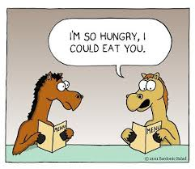
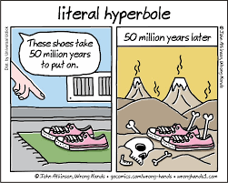
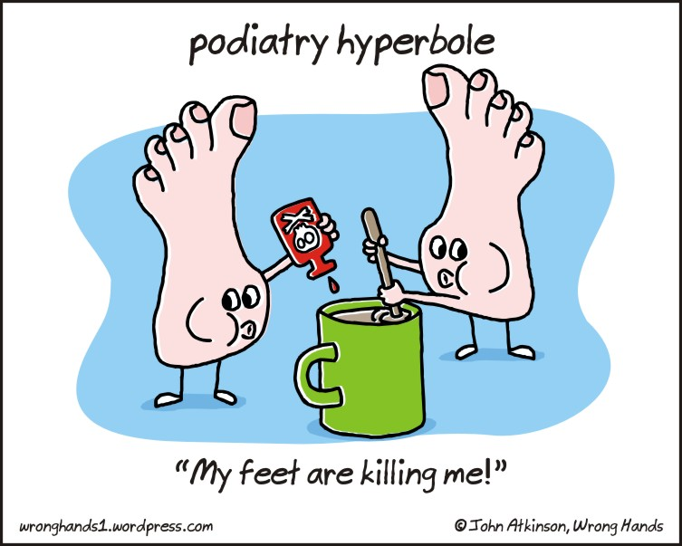
Hyperbole
is an obvious exaggeration or overstatement; not to be taken literally

Slide 23
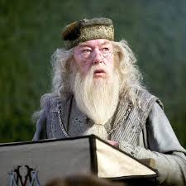
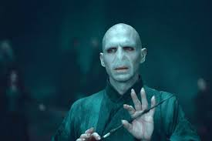
Foil
VS
Is another character in a story who contrasts with the main character, usually to highlight one of their attributes.
Example:
In the popular book series, Harry Potter, the character of Hogwarts principal Albus Dumbledore, who portrays ‘good’, is constantly shown to believe in the power of true love (of all forms and types) and is portrayed as a strong, benevolent and positive character while the antagonist Lord Voldemort, who depicts the evil and ‘bad’ in the series is constantly shown to mock and disbelieve the sentiment of love and think of it as a foolish indulgence, a trait that is finally his undoing.

Slide 24
Simile
Comparing this
A comparison using like or as
EXAMPLES:
“She looked like Heidi. Or Bo Peep” (Spinelli 8).
“I observed her as if she were a bird in an aviary” (Spinelli 16).
“She marched in, leading her girlfriends like an invading general” (Spinelli 27).
To this
What effect does the simile have on the reader?

Slide 25
Symbol
is using an object or action that means something more than its literal meaning
What do each of these symbolize?
Can you think of any more?

Slide 26
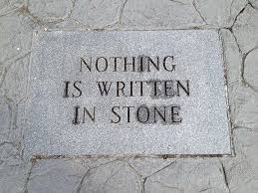
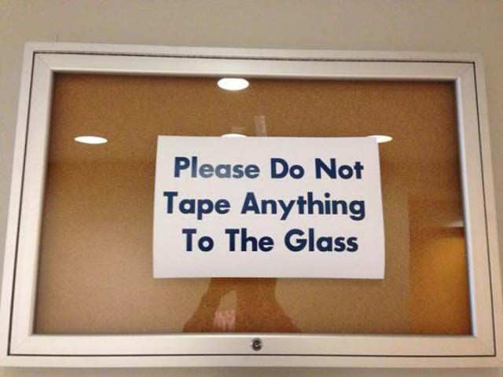
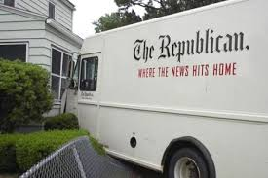
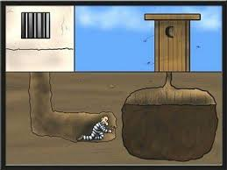
Ironic
A contrast between what you expect to happen and what actually happens

Slide 27
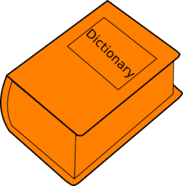
Diction
the words an author chooses to use in a piece of literature
denotation
connotation
the dictionary definition of a word; the literal meaning
the thoughts and feelings associated (connected) with the word; how a word makes you feel (positive or negative)

Slide 28
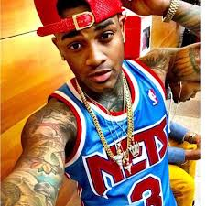
Connotation
What do you think of when you hear the word confident? What about conceited? They both have the same denotation (dictionary definition) but they carry different thoughts and feelings with them.

Slide 29
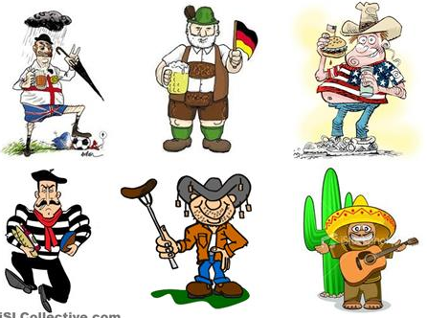
Stereotype
A picture in your head or an opinion you have, about a person or group of people based on the actions or behaviors of others that are similar.

Slide 30
Foreshadowing
https://youtu.be/LRVRxvNYR7Y
hinting at something that is or could happen in the future.

Slide 31
Plot
the sequence of events in a story

Slide 32
Metaphor
a comparison of two unlike things not using “like” or “as”
calling one thing something else
Example: “In school I was a yellow balloon, smiling and lazy, floating above the classrooms.
To this:
Comparing this:

Slide 33
Theme
Two question theme generator:
1. What is the story about?
EX: Overcoming obstacles, growing up, dealing with
death, love, or hate. The deeper meaning
2. What is the author telling us about ___________?
EX: love, or death
The author’s name, the title of the book, and the answer to the question.
EX: Ray Bradbury, in the novel Fahrenheit 451 is
about____________
moral or point of the story; what the author wants the reader to walk away with
themes can be revealed by:
- a story’s title
- key phrases and statements about big ideas
- the ways the characters change and the lessons they

