Slide 1
Writing a Myth

Slide 2
What is required in our myth?
Theme: lesson or moral of the story
Flawed Character
Natural Phenomenon
Four Literary Devices

Slide 3
Personification
It is when an author gives human characteristics to a nonhuman thing.
Examples:
My car drank the gasoline in one gulp. The cat laughed. The newspaper headline glared at me.

Slide 4
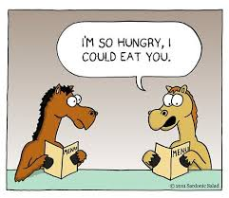
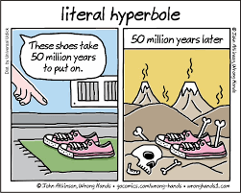
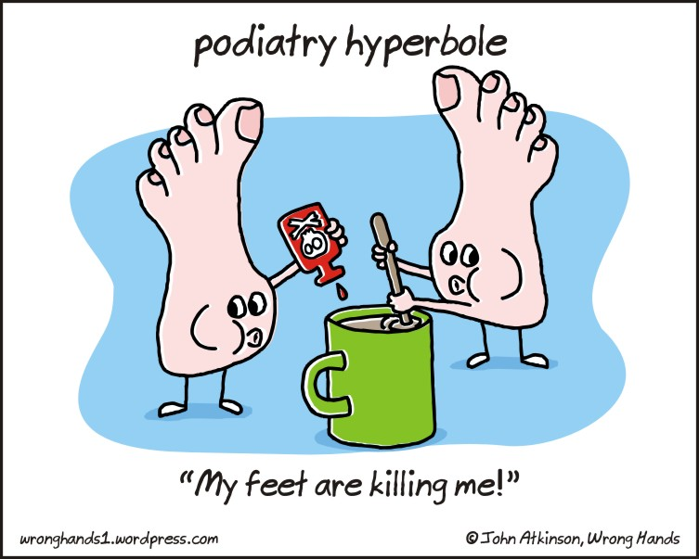
Hyperbole
is an obvious exaggeration or overstatement; not to be taken literally

Slide 5
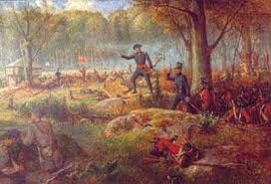
Simile
Comparing this
A comparison using like or as
EXAMPLES:
“She looked like Heidi. Or Bo Peep” (Spinelli 8).
“I observed her as if she were a bird in an aviary” (Spinelli 16).
“She marched in, leading her girlfriends like an invading general” (Spinelli 27).
To this
What effect does the simile have on the reader?

Slide 6
Metaphor
a comparison of two unlike things not using “like” or “as”
calling one thing something else
Example: “In school I was a yellow balloon, smiling and lazy, floating above the classrooms.
To this:
Comparing this:

Slide 7
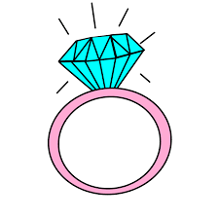
Symbol
is using an object or action that means something more than its literal meaning
What do each of these symbolize?
Can you think of any more?

Slide 8
What Makes our stories good? How can we show vs tell?

Slide 9
Imagery
when the author uses any of the five senses to create vivid picture in your mind; movie reel effect
Five senses include:
Visual
Auditory
Touch
Taste
Smell

Slide 10
Dialogue
It is a conversation between two or more people in a work of literature
It is not just words spoken; instead, dialogue reflects an active choice made on the part of each character to instigate conflict and resolve problems, ask and answer questions, and push the narrative along in numerous ways. The way that characters speak hints at their underlying psychoses, desires, motivations, opinions, and so on.

Slide 11
Exposition
Is the introduction to characters and setting
Be sure to create a mood
You don’t want more than two or three characters

Slide 12
Setting
The time and place in which the events of a work of literature take place.
Needs to be a long time ago before most natural phenomenons were created or existed
Ex: A long, long time ago….
In ancient times….
Any more?

Slide 13
Characterization
Is the process by which the writer reveals the personality of a character.
Indirect
Direct
the author shows us the character but allows us to interpret for ourselves what kind of person the character is
the author tells readers directly what a character is like or what a person’s motives are

Slide 14
From the stories that we have read so far, what are some elements we could utilize in our story?
trickery
magical powers/superpower
theme/moral/lesson
Set in the past
transformation/shapeshifter
animal character
mythological creatures

