Slide 1
Natural Phenomenon Ideas

Slide 2
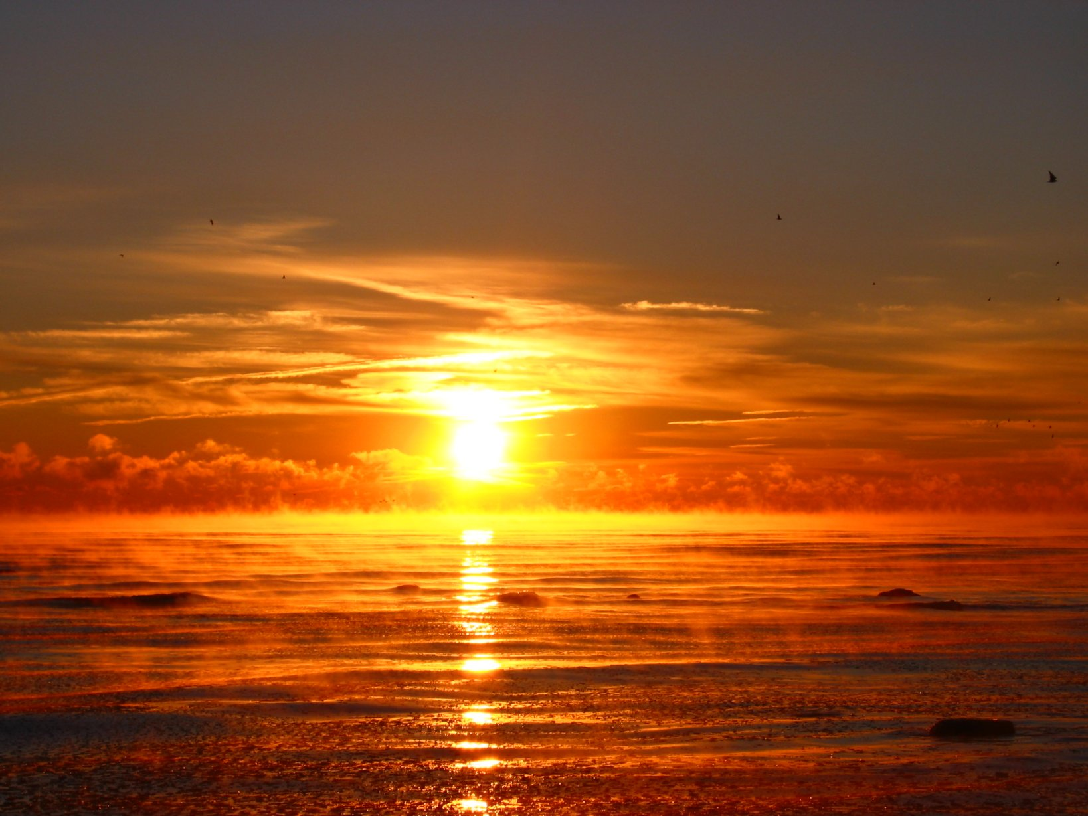
Sunrise

Slide 3
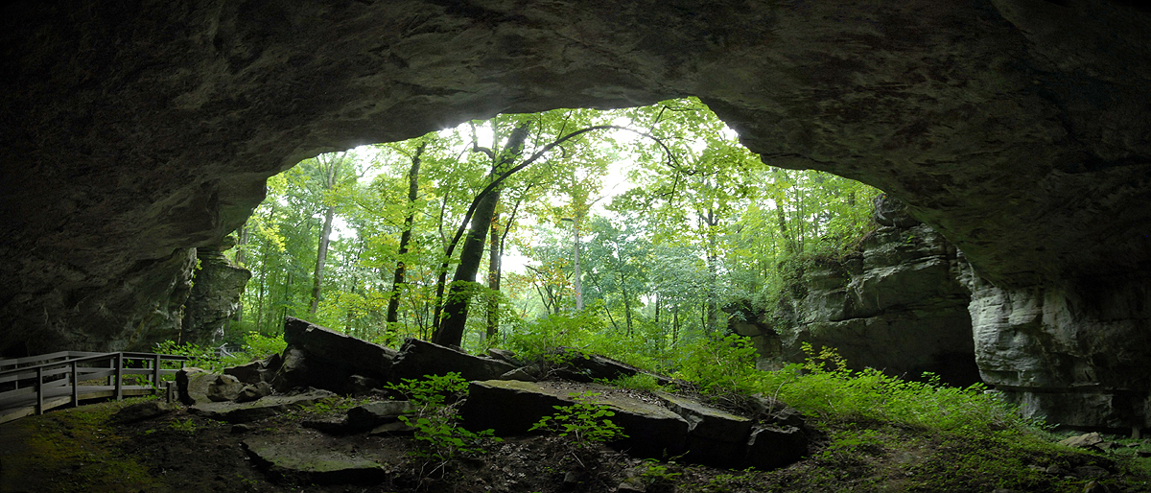
Caves

Slide 4
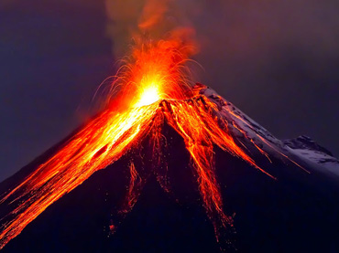
Volcano

Slide 5
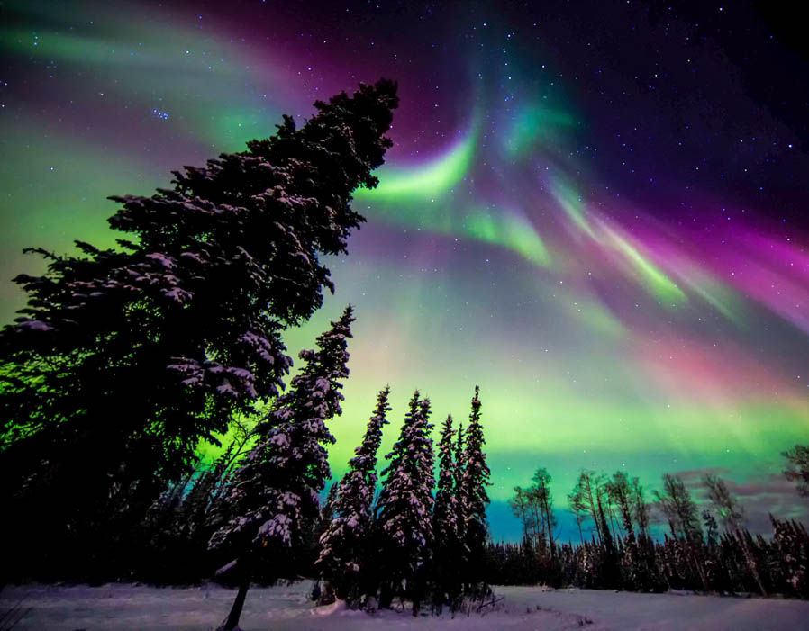
Northern Lights
Aurora Borealis more commonly named The Northern Lights. Are glowing lights that appear in the sky. They are electrons colliding with the upper reaches of Earth’s Atmosphere.

Slide 6
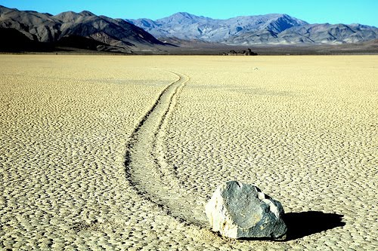
Sailing Stones
Sailing stones, also known as sliding rocks, rolling stones, and moving rocks, are a geological phenomenon where rocks move and inscribe long tracks along a smooth valley floor without human or animal intervention.

Slide 7
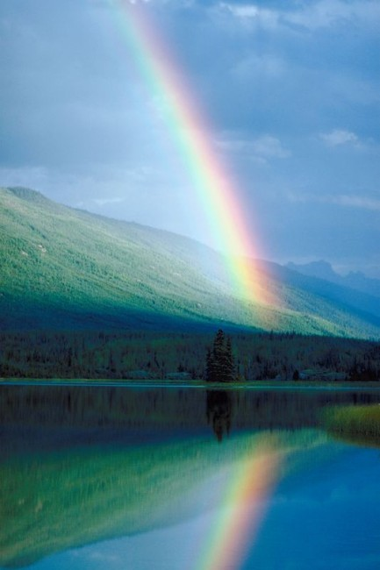
Rainbows

Slide 8
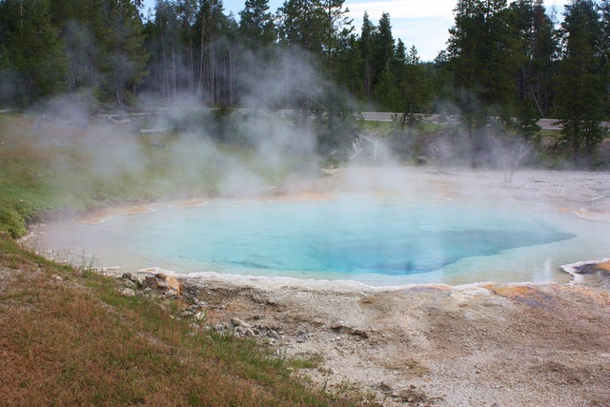
Hot Springs
A hot spring is a spring produced by the emergence of geothermally heated groundwater that rises from the Earth's crust. There are geothermal hot springs in many locations all over the crust of the earth

Slide 9
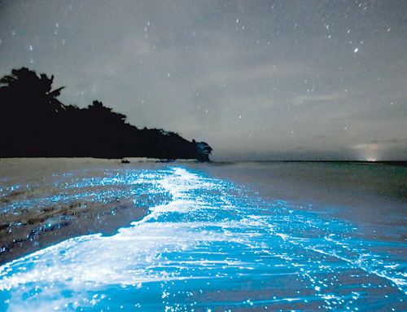
Bioluminescent Waves

Slide 10
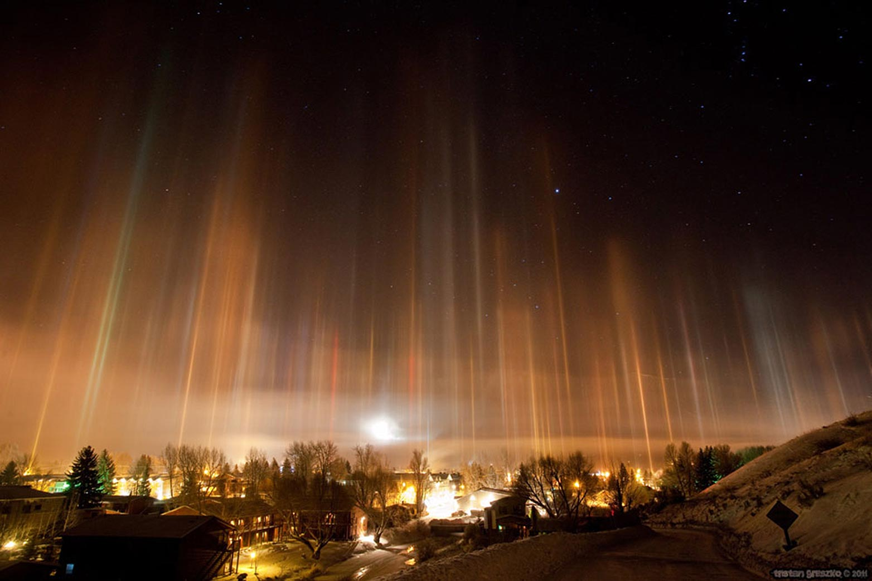
Light Pillars

Slide 11
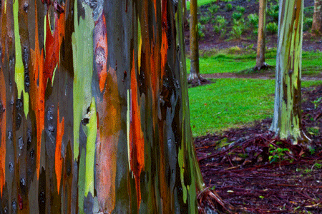
Rainbow Eucalyptus

Slide 12
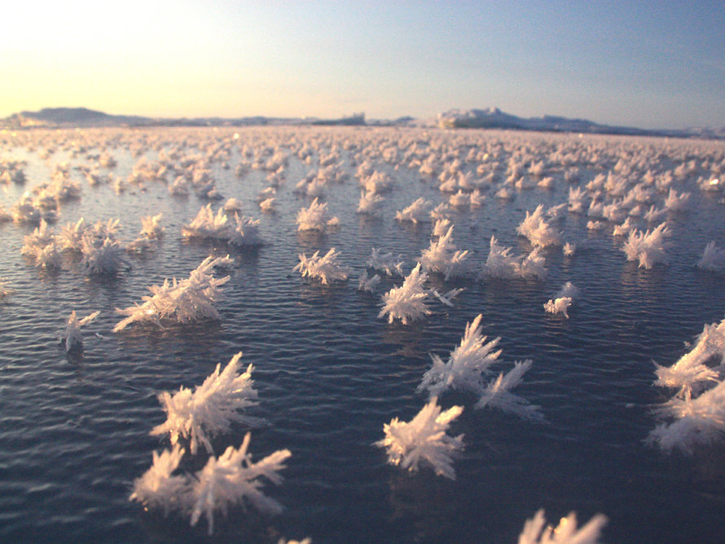
Frost Flowers

Slide 13
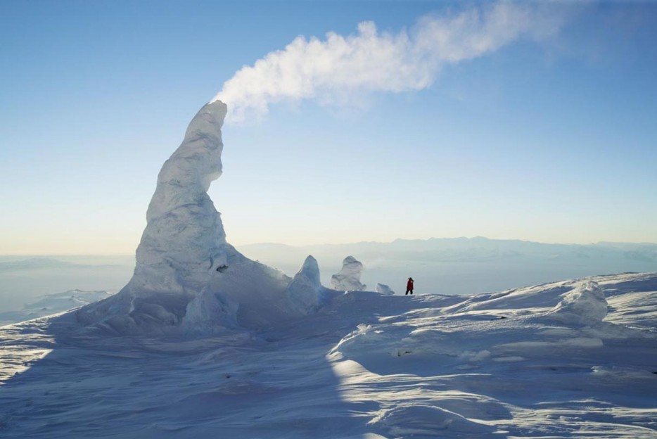
Snow Chimneys

