Slide 1
Spring Tone Words

Slide 2
agitated- feeling or appearing to be nervous or troubled

Slide 3
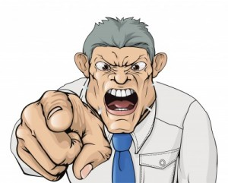
authoritative- trusted as being accurate or true; reliable; commanding,
OR

Slide 4
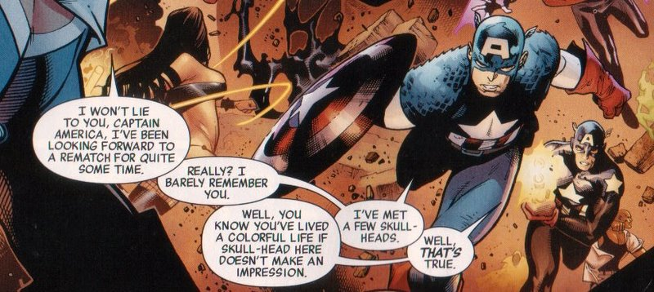
bantering- talk or exchange remarks in a good-humored teasing way

Slide 5
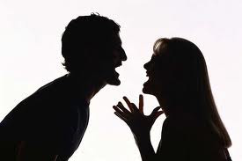
caustic- harsh or destructive in tone; sarcastic

Slide 6
conventional- following traditional forms & genres; based on what is generally done or believed

Slide 7
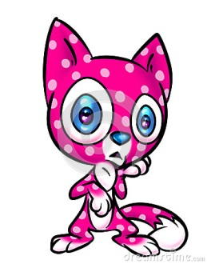
droll- curious or unusual in a way that provokes dry amusement

Slide 8
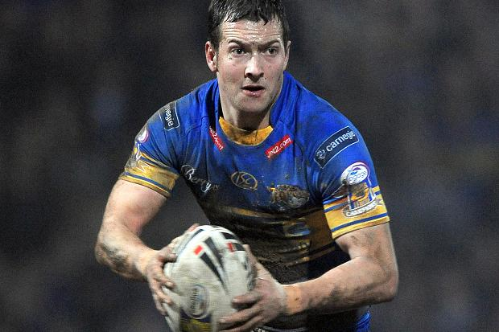
earnest- showing sincere and intense conviction

Slide 9
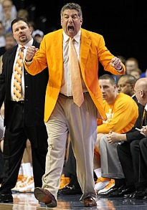
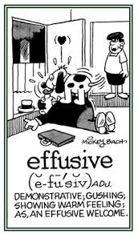
effusive- emotionally excessive; overly demonstrative

Slide 10
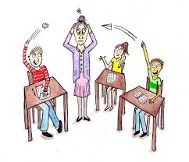
flippant- lacking in seriousness; disrespectful

Slide 11
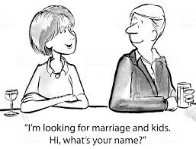
forthright- frank, direct, straightforward

Slide 12
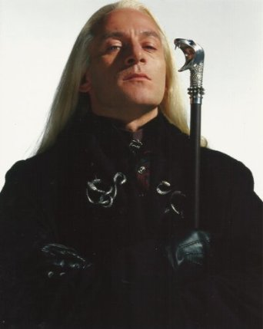
haughty- arrogantly superior and scornful

Slide 13
indignant- angered at something unjust or wrong

Slide 14
judgmental- displaying an excessively critical point of view; condemning others’ behavior

Slide 15
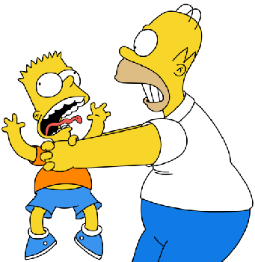
malicious- intending or intended to do harm

Slide 16
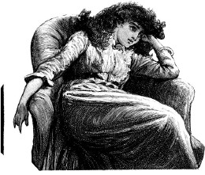
morose- characterized by gloom, withdrawn

Slide 17
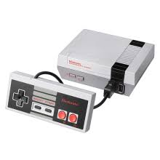
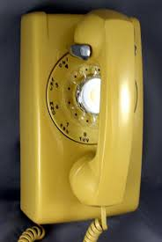
nostalgic- a sentiment for the past, typically for a period or place with happy personal associations

Slide 18
ominous- a warning or feeling that something bad will happen

Slide 19
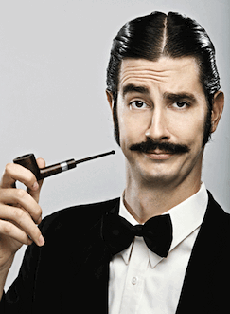
pretentious- attempting to impress by displaying greater importance, talent, culture, etc., than is actually possessed.

Slide 20
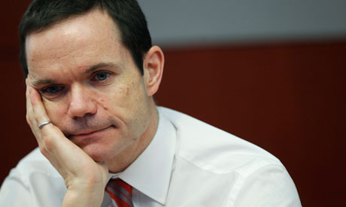
resigned- accepted that there is nothing that can be done about something unpleasant

Slide 21
solemn- not cheerful or smiling; serious; deep sincerity

